Slide 1
Generation of ELECTRICITY form Noise Pollution

Slide 2

TOLANI POLYTECNIC COLLEGE
TOPIC :- GENERATION OF ELECTRICITY FROM NOISE POLLUTION.
BRANCH:- DIPLOMA ELECTRICAL ENGINEEING
SEMESTER:- 6TH
BATCH:- 1
GUIDED BY :- J.K.RATHOD (H.O.D)
NIMESH PRAJAPATI

Slide 3
TEAM!
AJIT KULKARNI 196510309005
AYUSH SRIVASTAVA 196510309011
ARJUN CHANGLA 196510309013
HARSHVARDHAN 196510309019
GADHVI

Slide 4
COMMON ALTERNATIVE SOURCE OF ENERGY
1
.

Slide 5
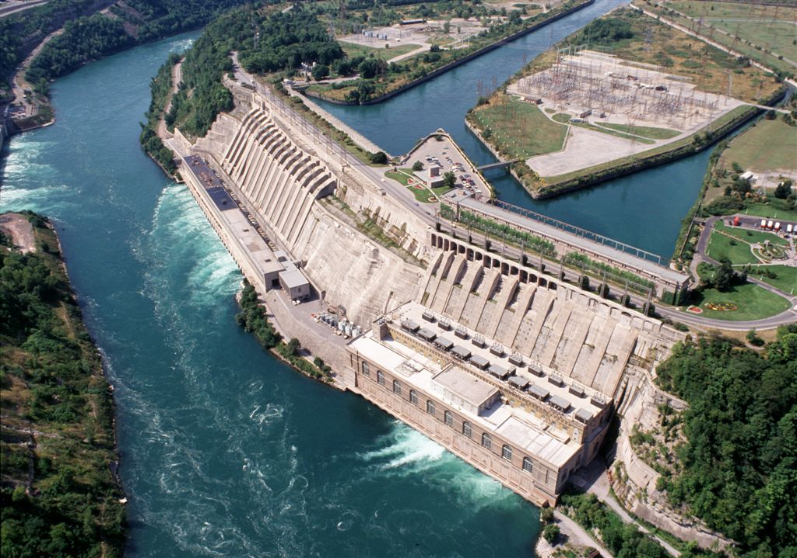
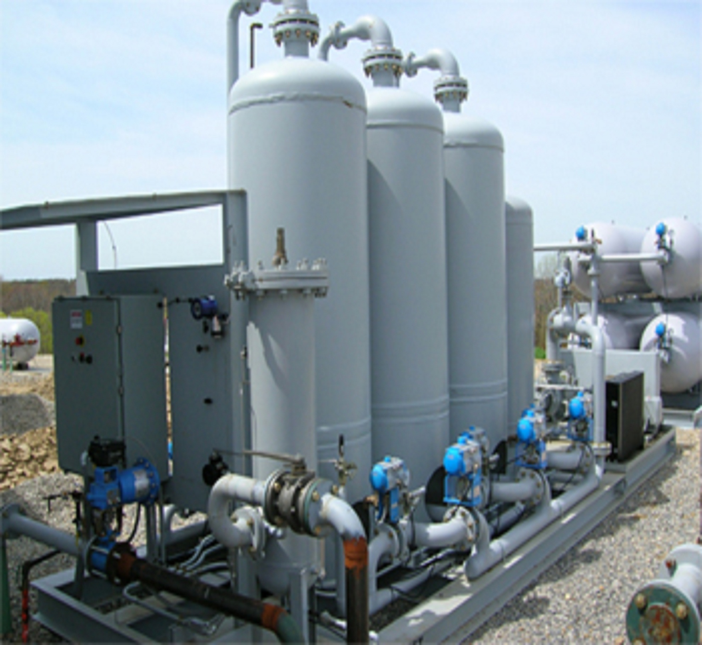
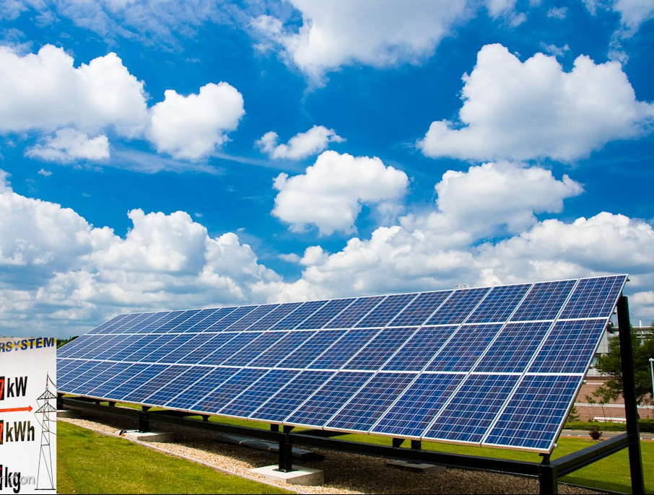
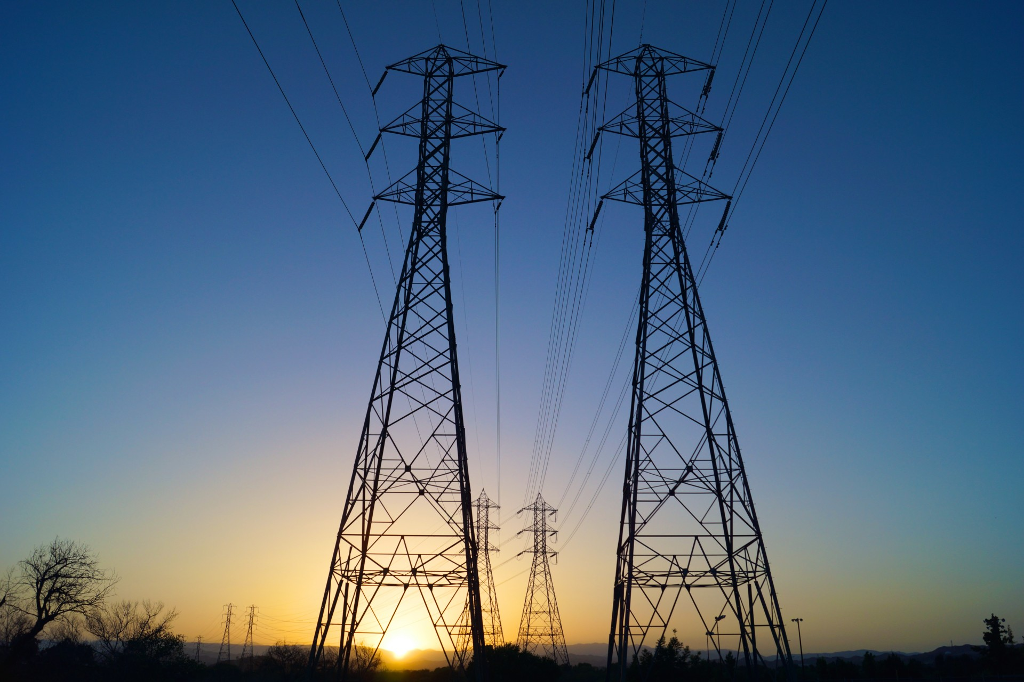
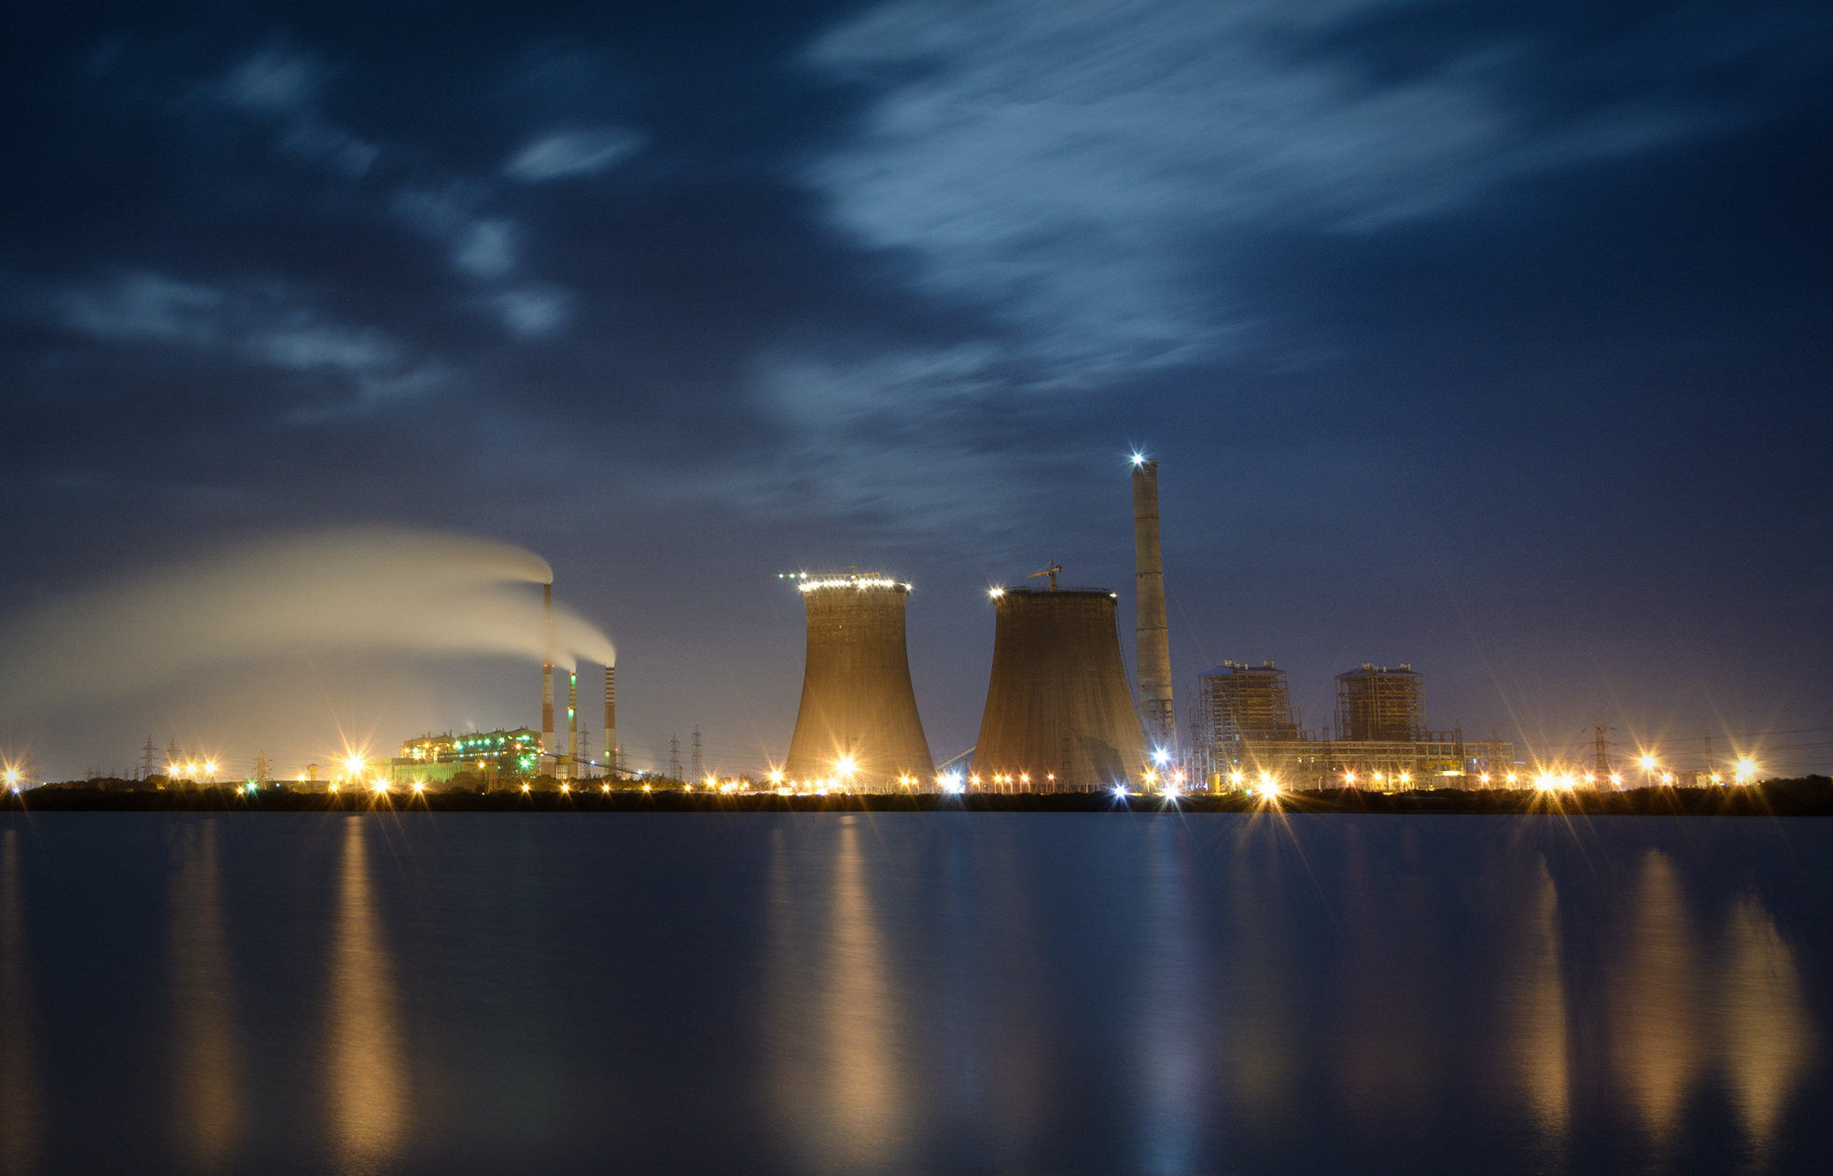
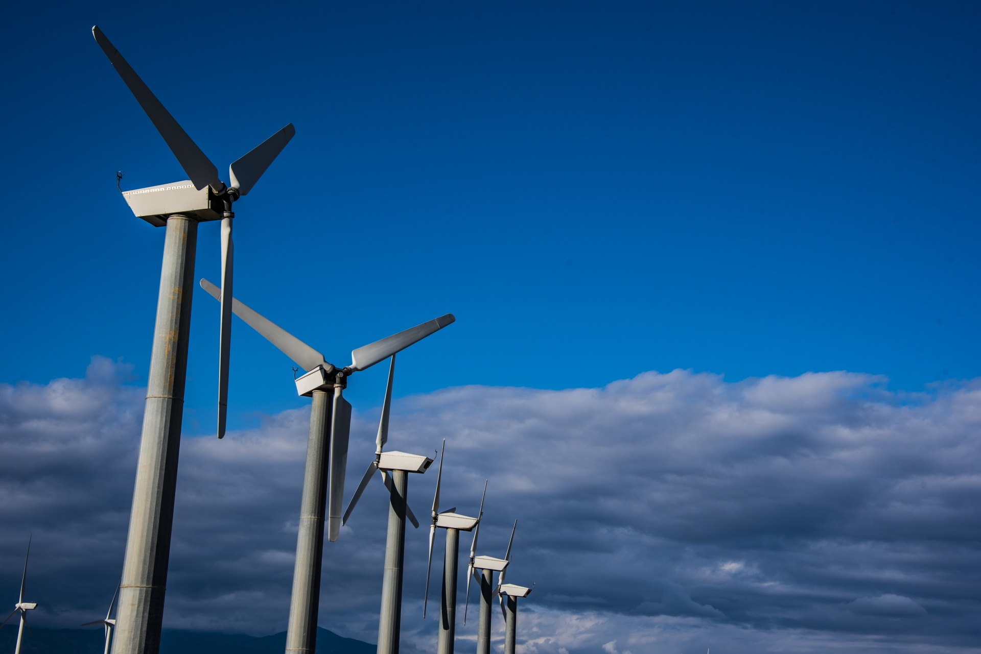
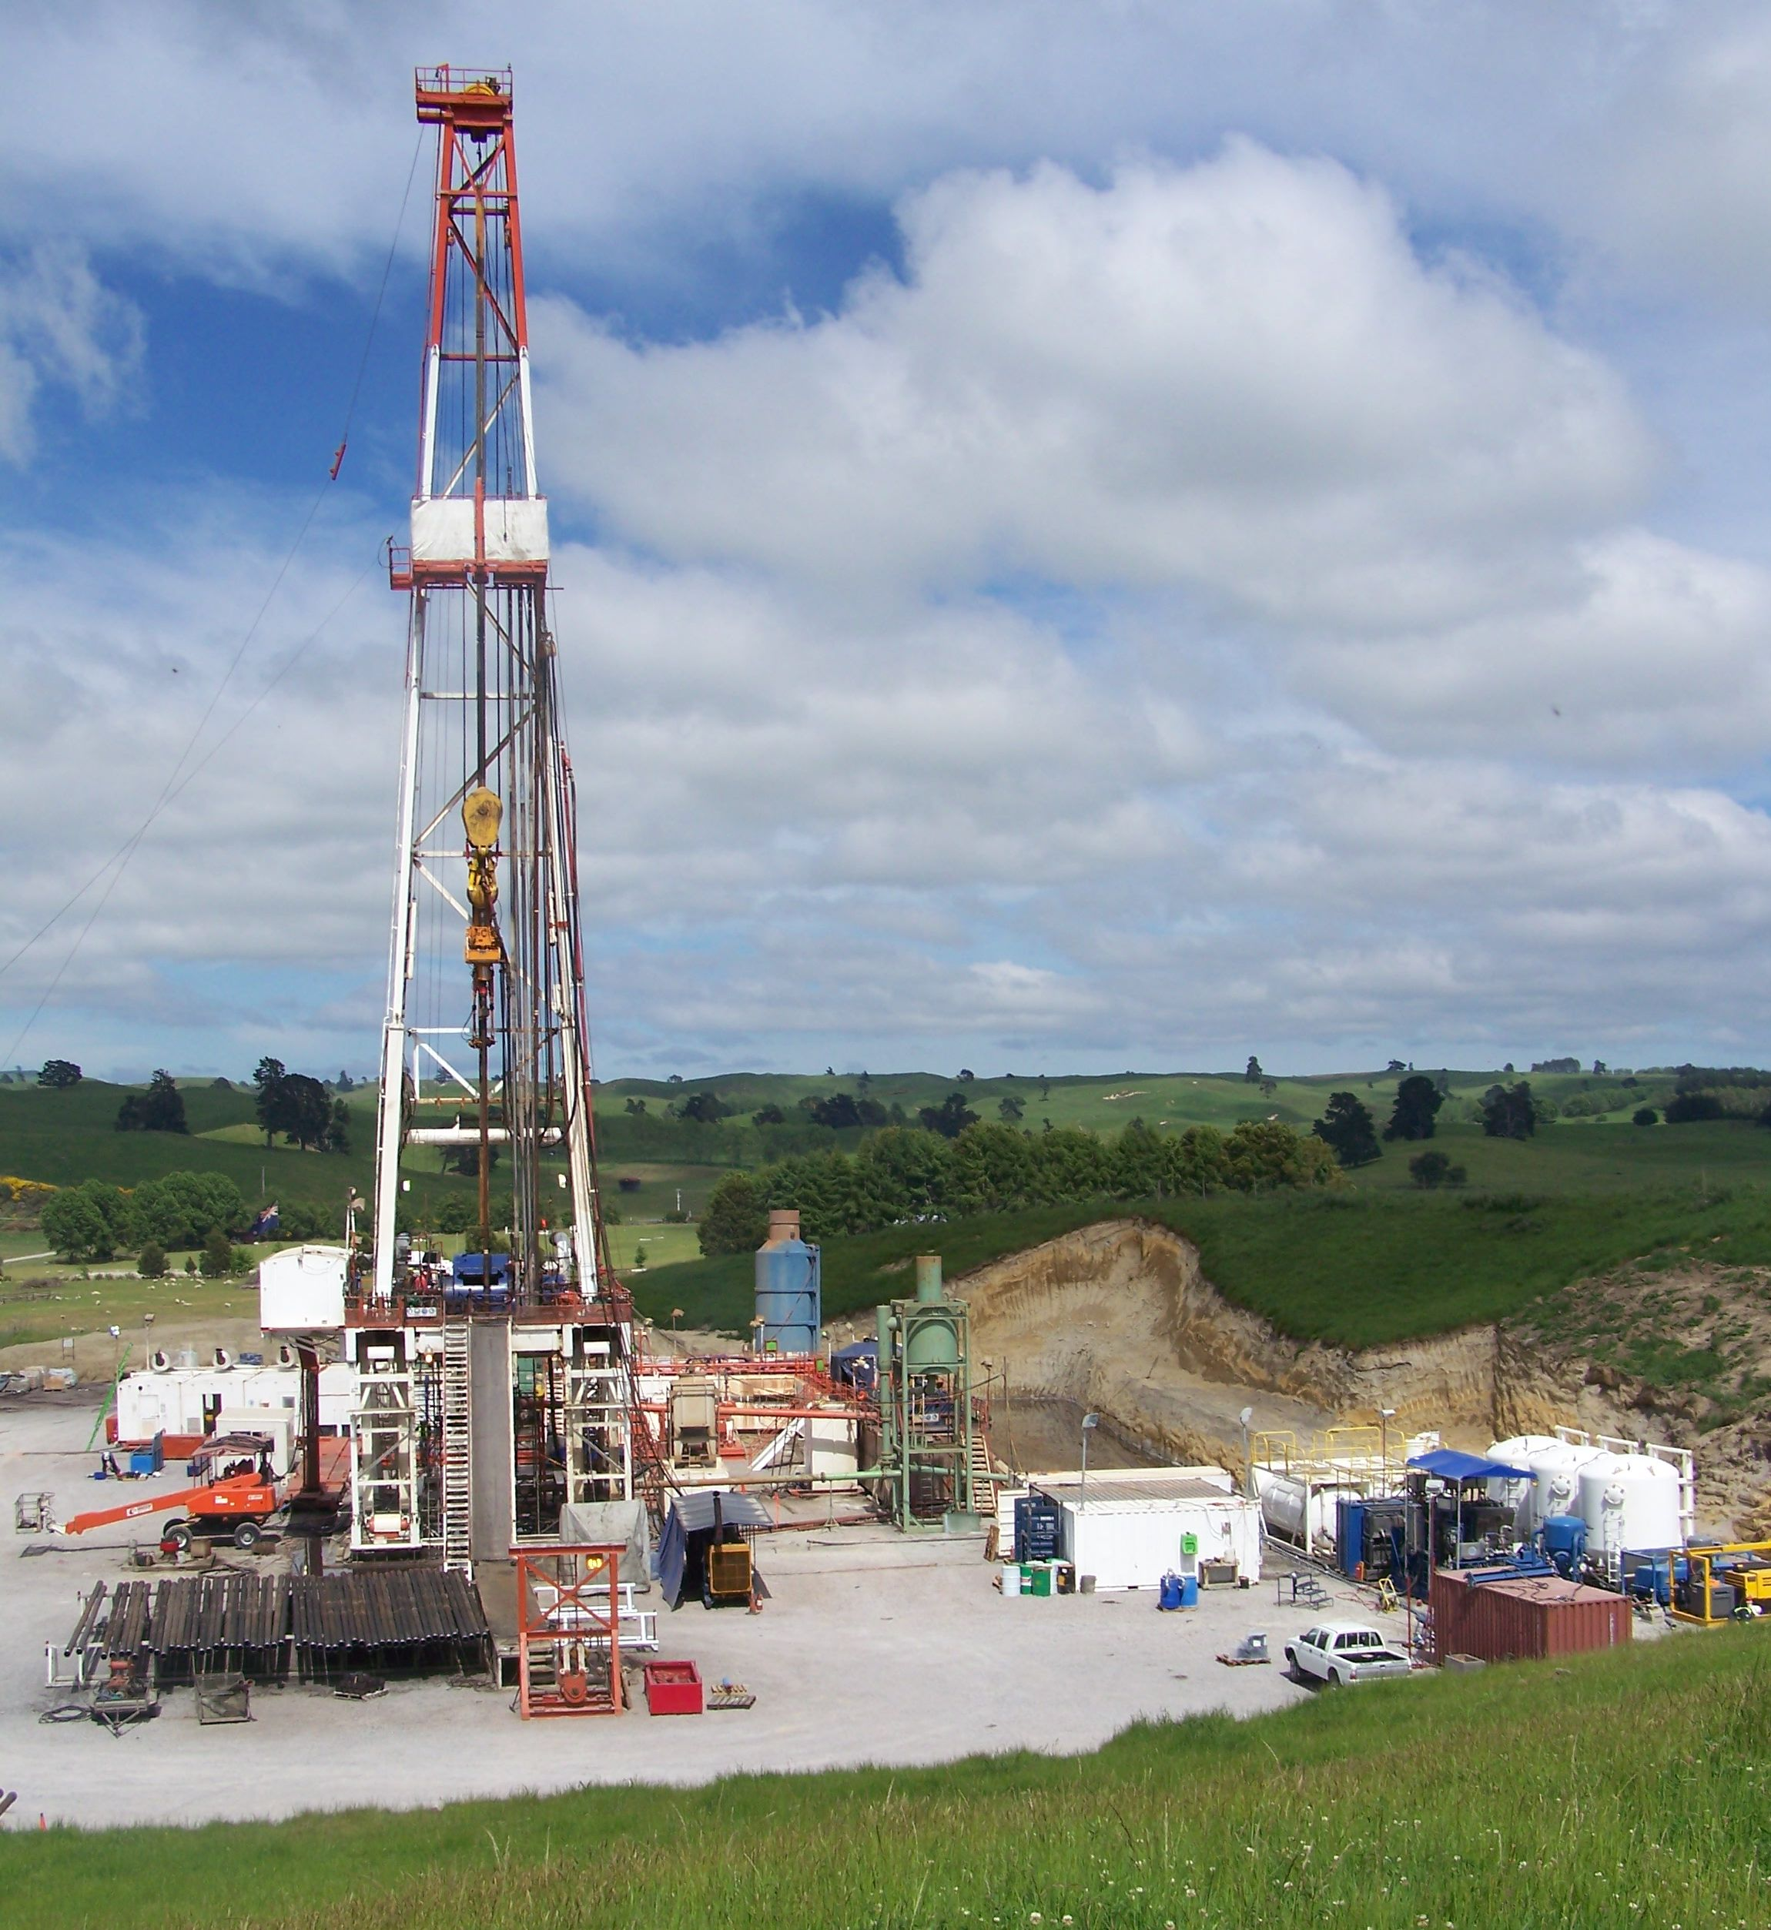

Slide 6
BUT!!!! THERE IS ONE MORE SOURCE OF ENERGY SOUND ENERGY

Slide 7
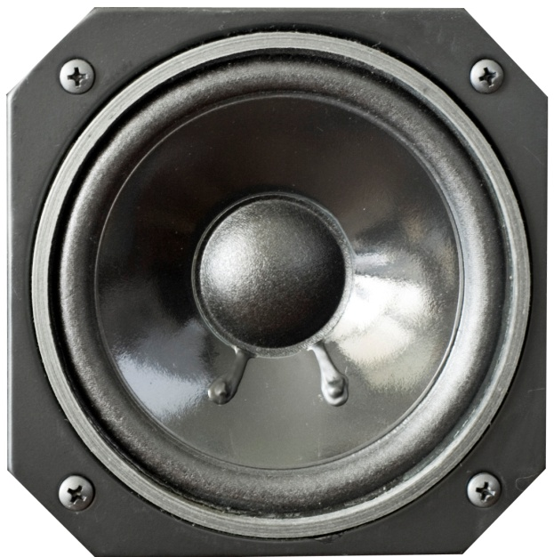

CAN YOU EVER HEARD ABOUT CONVERSION OF SOUND ENERGY TO ELECTRICAL ENERGY

Slide 8
Yes. Sound has a potential to produce the electrical energy. But how? In our surrounding there is too much of noise(sound vibration or sound signals). So, with the help of absorbing speaker(which absorbs the sound energy) and step up signal transformer . We can produce the electrical energy.

Slide 9
How much energy could we produce ?
For each 100db we get 0.5 volts
1000db 5volts

Slide 10

Where can we harvest sound?
1) TRAFFIC AREA :- 95-105 Db

Slide 11
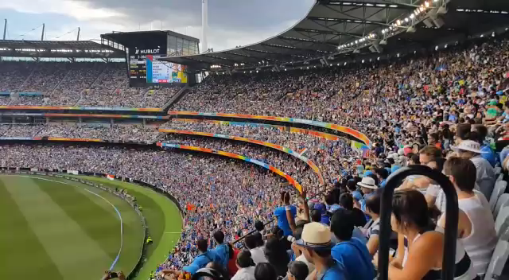
.
2) CRICKET STADIUM:- 105-130 Db

Slide 12
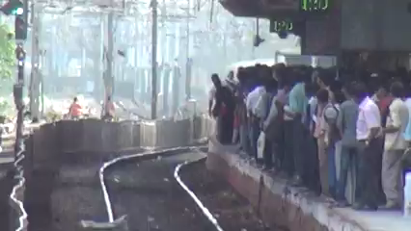
.
3) RAILWAY STATION:-80-105 DB

Slide 13
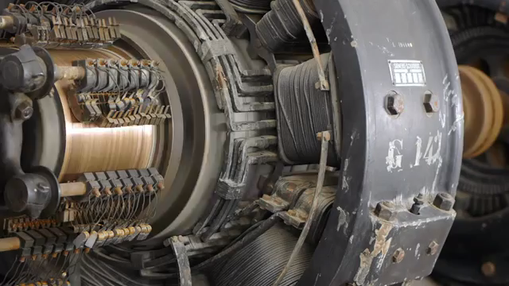
.
4) INDUSTRIAL AREA :- 75-100 Db

Slide 14

.
5) LIVE CONCERT :- 100-120 Db

Slide 15
COMPONENTS
2
.

Slide 16
SPEAKERS
&
AMPLIFIER
TRANSFORMERS
COMPONENTS
LED LIGHT
&
CAPACITOR
PCB
&
CARDBOARD
SWITCHES
&
INDICATOR
CONNECTING
WIRES

Slide 17
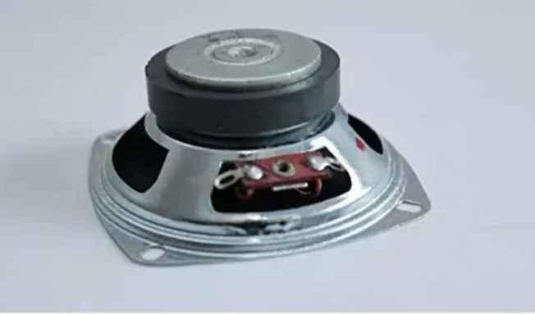
ABSORBING SPEAKERS
1 ) THIS IS THE MAIN COMPONENT OF THE PROJECT.SPEAKER IS USE TO ABSORB THE SURROUNDING SOUND.
2) SPEAKER SIZE :- 3 INCH
3)- SPEAKER PRICE :- 150 RS 1 UNIT
4) REQUIRED SPEAKER :- 6 UNIT

Slide 18

STEP-UP SIGNAL TRANSFORMER
THE MAIN WORK OF TRANSFORMER IS TO INCERASE THE LEVEL OF SIGNAL COMING FROM THE SPEAKERS.
(LOW SIGNAL ---- HIGH SIGNAL)
TRANSFORMERS RANGE– 5V TO 50V
TRANSFORMERS PRICE – 200RS – 1 UNIT
REQUIRED TRANSFORMER – 2 UNIT

Slide 19
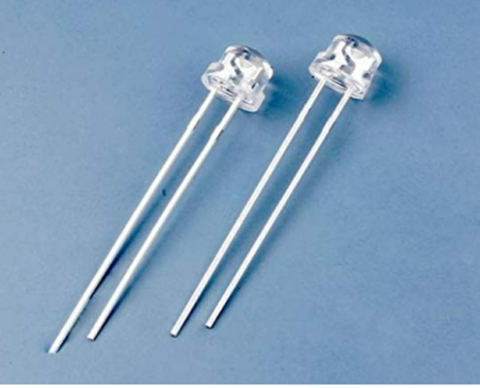
LED
(LIGHT EMITTING DIODE) = LED IS USED IN STREET LIGHT AND BUILDING , ETC.

Slide 20
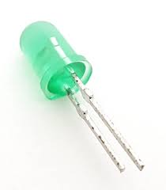
INDICATING LIGHT
A small electric light used to indicate something... often used to show an operating condition or whether power is on, these lights come in a range of colors and voltages

Slide 21
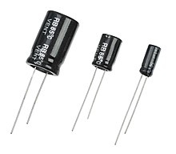
CAPACITOR
The capacitor is a component which has the ability or “capacity” to store energy in the form of an electrical charge producing a potential difference (Static Voltage) across its plates, much like a small rechargeable battery.

Slide 22
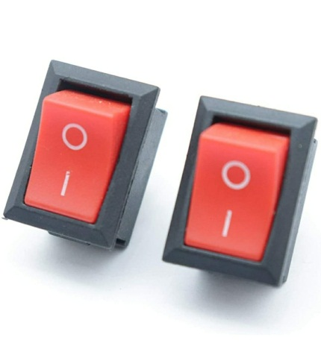
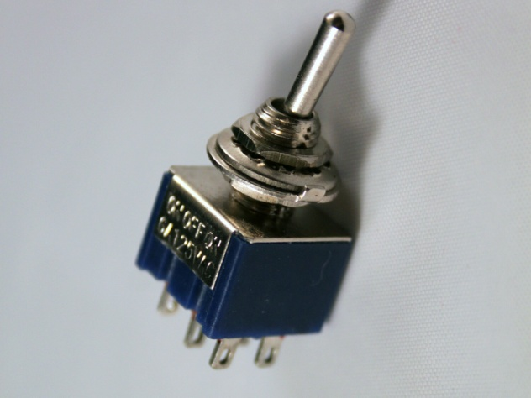
SWITCHES
SWITCHES: - IT IS USED TO ON/OFF. It is also used to complete the circuit.
1)One way switches
2) Two way switch:- In a two-way switch, there are two, one-way switches combined in one. One of the terminals can be connected to either of the two, but not both at the same time. The advantage of a two-way switch is the ability to control a single device from two separate locations.

Slide 23
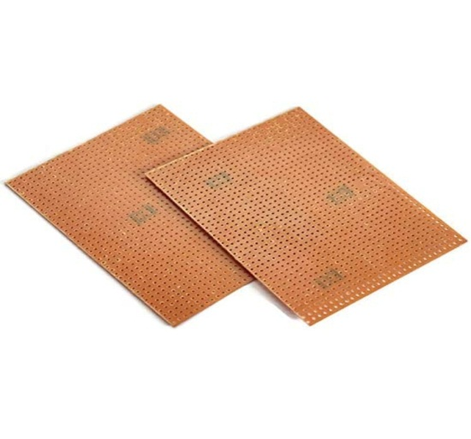
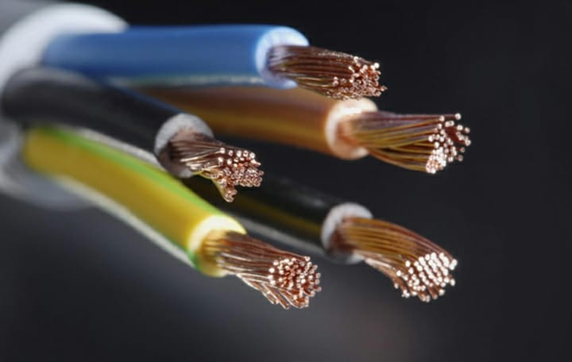
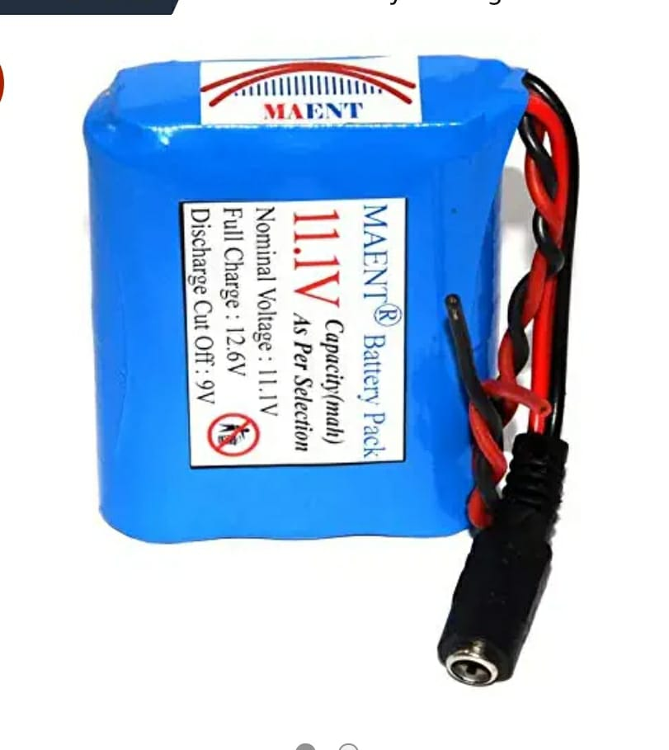
PCB,CONNECTING WIRES & RECHAREGABLE BATTERY
*PCB: - PRINTED CIRCUIT BOARD.PCB IS USE BOTH FOR BORE AND ASSEMBLED BOARDS .
PRICE– 69RS
*CONNECTING WIRES: - WIRES ARE USED TO CONNECT THE EQUIPMENT FROM EACH OTHER (LUMP SUM).
*BATTERY: - IT IS USED TO BE STORE THE POWER GENERATED FROM THE SPEAKER.
PRICE: - 400RS
REQUIRED: - 7

Slide 24
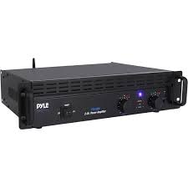
POWER AMPLIFIER
A power amplifier is an electronic amplifier designed to increase the magnitude of power of a given input signal. The power of the input signal is increased to a level high enough to drive loads of output devices like speakers, headphones, RF transmitters etc. ... In this case, a microphone is used as an input source.

Slide 25
WORKING PRINCIPLE
3
.

Slide 26
PRINCIPLE
The conversion of sound energy into
electrical energy.
when the sound energy (signals) are absorbed by absorbing speaker.
and then the soft layer of diaphragm on the upper side get vibrate.
by this vibration the moving coil in it also vibrate .

Slide 27
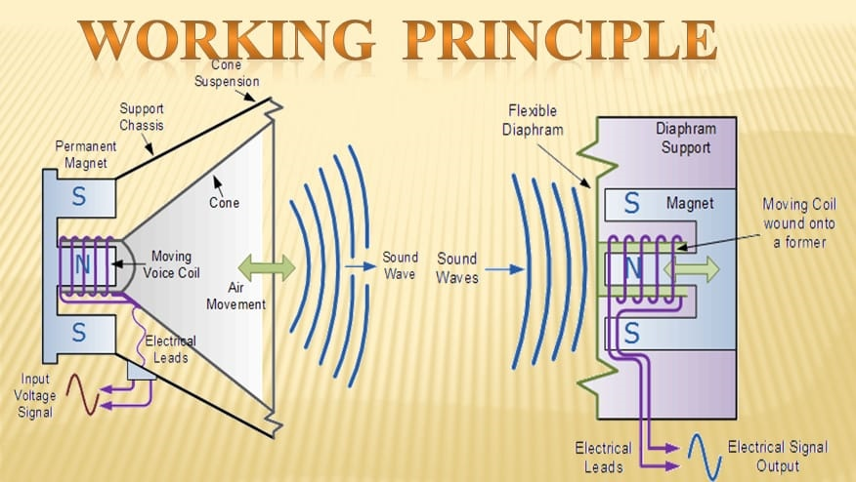
PRINCIPLE
.
. AND WITH THE HELP OF FIELD MAGNET THE VIBRATION CUTS THE FIELD FLUX LINE .
AND THE ELECTRICAL SIGNAL ARE PRODUCED .
THESE ELECTRIC SIGNAL ARE STEP – UP AND CAN BE USED AS ELECTRICAL ENERGY.

Slide 28
DECIBLE CHART OF DIFFERENT AREAS
4
.

Slide 29
.
.

Slide 30
USES
5
.

Slide 31
.
NOTE : - AS PER WE KNOW THAT THE POTENTIAL OF ENERGY PRODUCED BY SOUND IS A BIT LESS THAN OTHER SOURCES OF ENERGY . HENCE , WE HAVE TO MAKE THE USE OF THIS ENERGY AS PER NEARBY LOCATIOIN. SO WITH THAT WE CAN REDUCE THE LOSSES IN TRANSMISSION AND ITS EFFICIENCY WILL INCREASE.
.

Slide 32
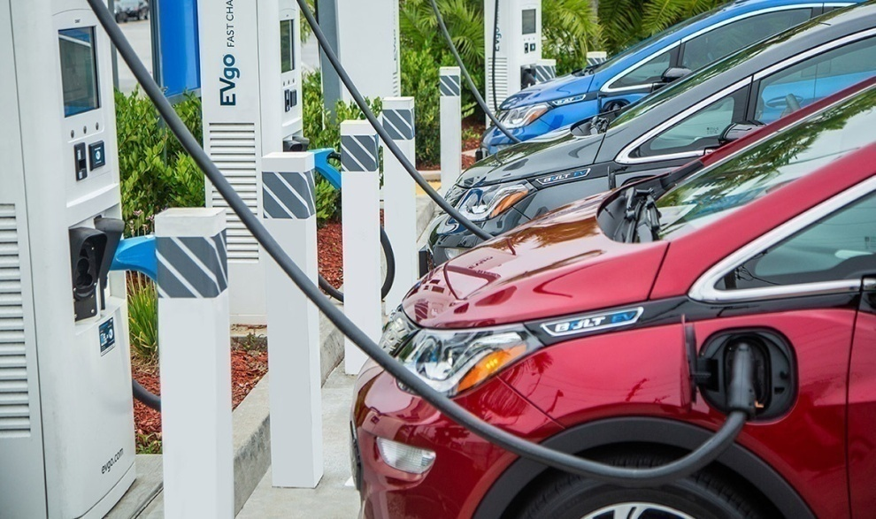
ELECTRIC CAR CHARGING
AS CHARGING STATION ARE NEARER TO ROADS SO THE ENERGY PRODUCED BY SOUND IS TRANSMITED TO THE STATION AND MAKE THE USE OF THIS.FROM OUR RESEARCH WE HAVE FOUND THAT THE ROAD BETWEEN DELHI TO CHANDIGARH HAS BECOME THE FIRST ELECTRIC ROAD AND IN FUTURE IT WILL INCREASE THE ELECTRIC CRISIS IN INDIA . SO WITH THIS SOUCRE WE CAN OVERCOME THE SITUATION

Slide 33
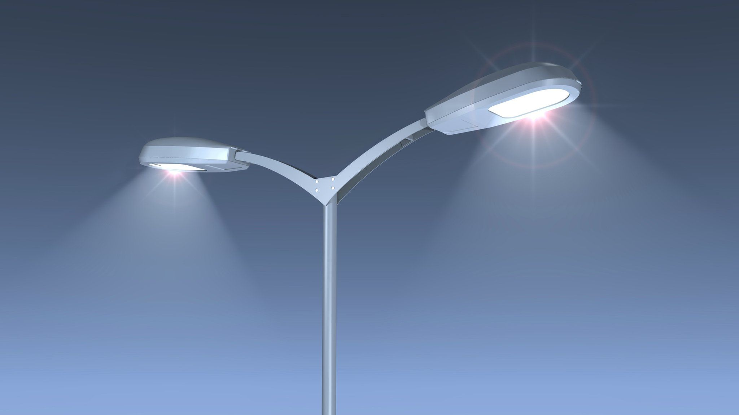
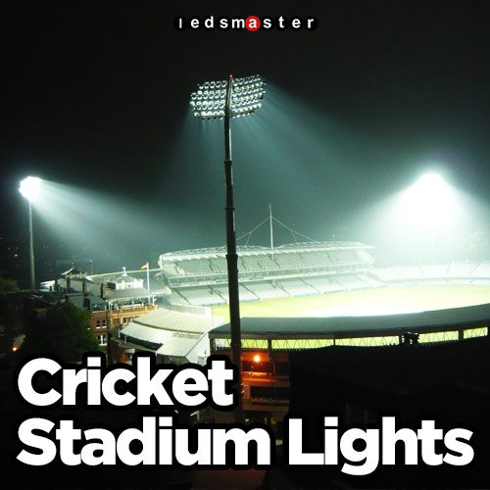
STREET LIGHTS & CRICKET STADIUM LIGHTS
THIS ELECTRICAL ENERGY IS USED TO GLOW THE STREET LIGHTS AND CRICKET STADIUM LIGHTS. AND ANY OTHER PLACES WHERE DECORATIVE LIGHTS ARE REQUIRED.

Slide 34
PROJECT MODEL & WORKING
6
.

Slide 35
PROJECT MODEL PICTURE
.

Slide 36
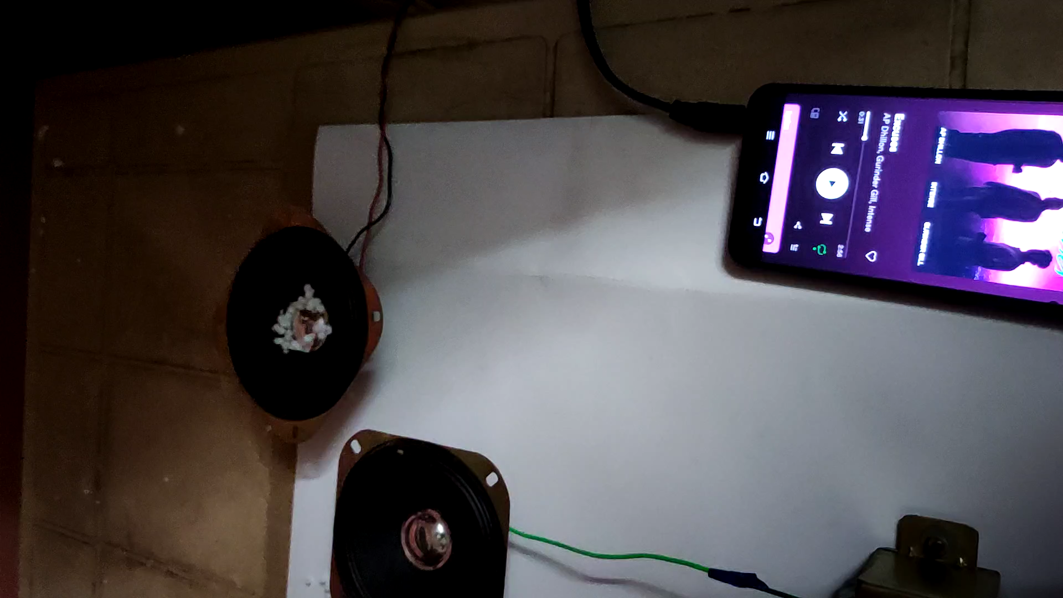
WORKING DEMO
.

Slide 37
THANK YOU

